Slide 1
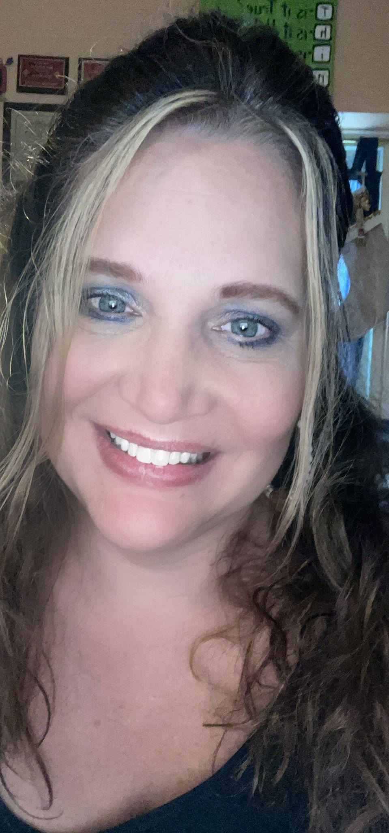
Dr. Lee
Get to know your teacher!
This is my 28th year teaching. As well as being a teacher, I am also a college professor.

Slide 2
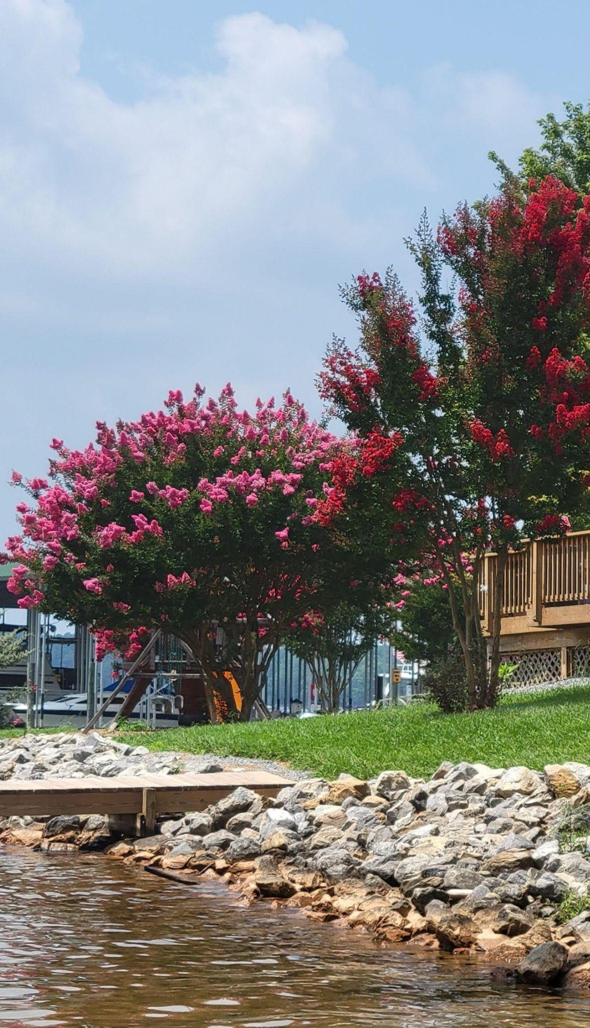
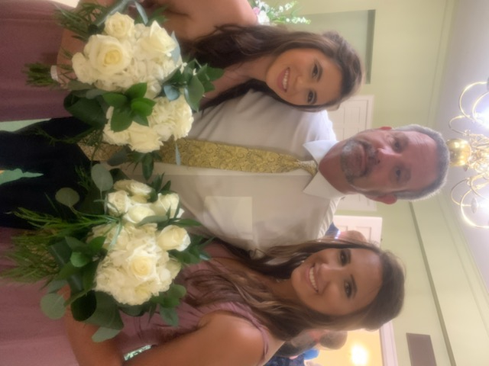
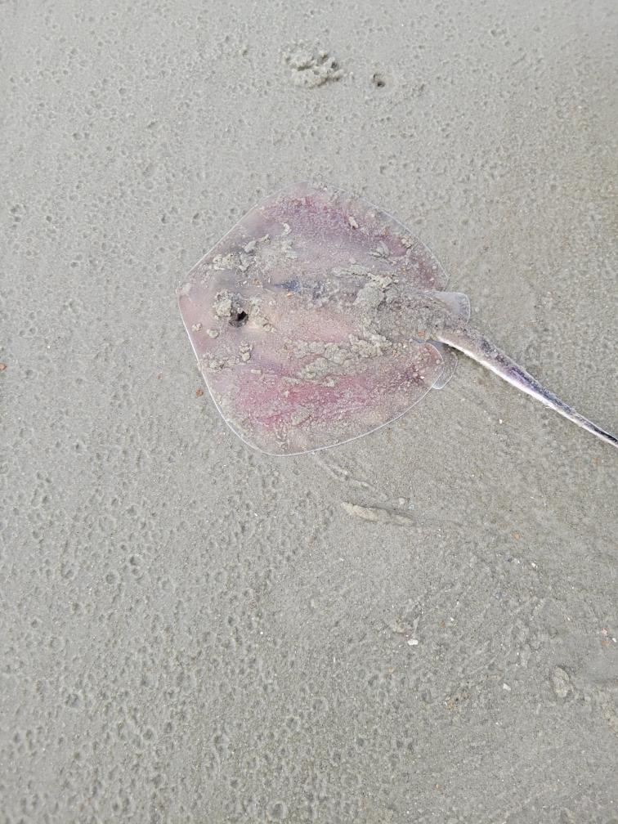
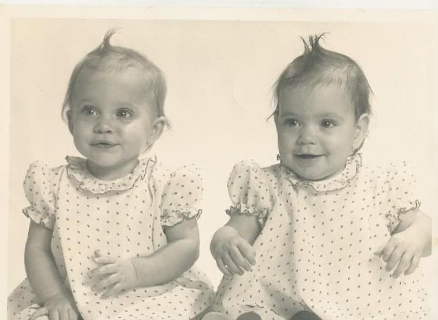
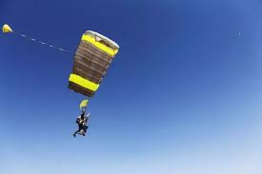
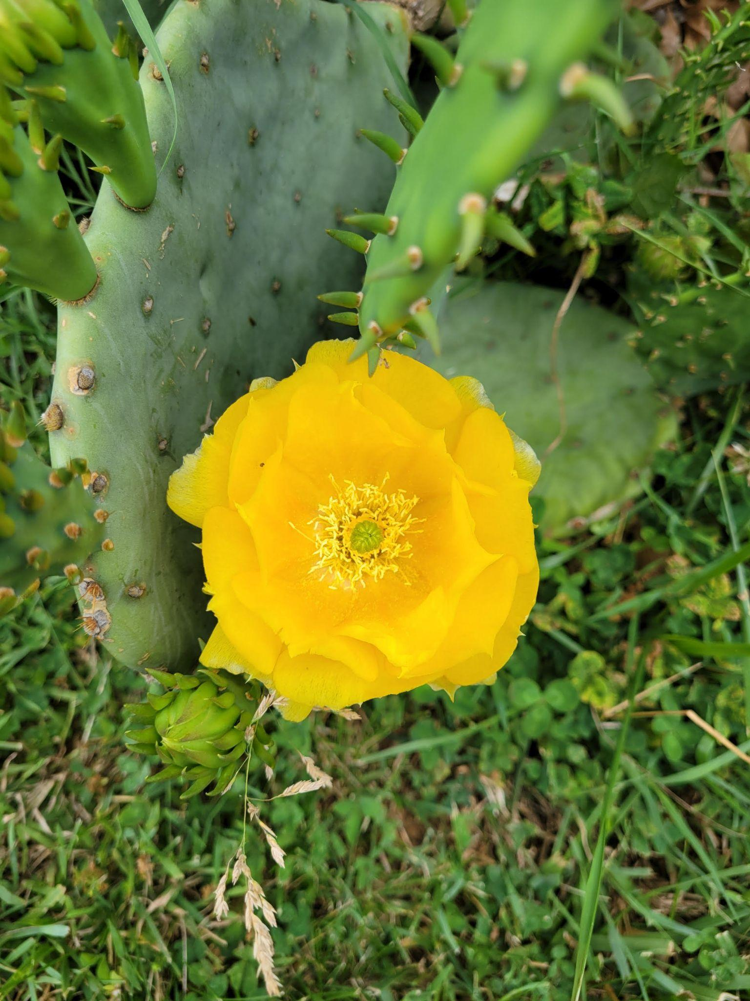
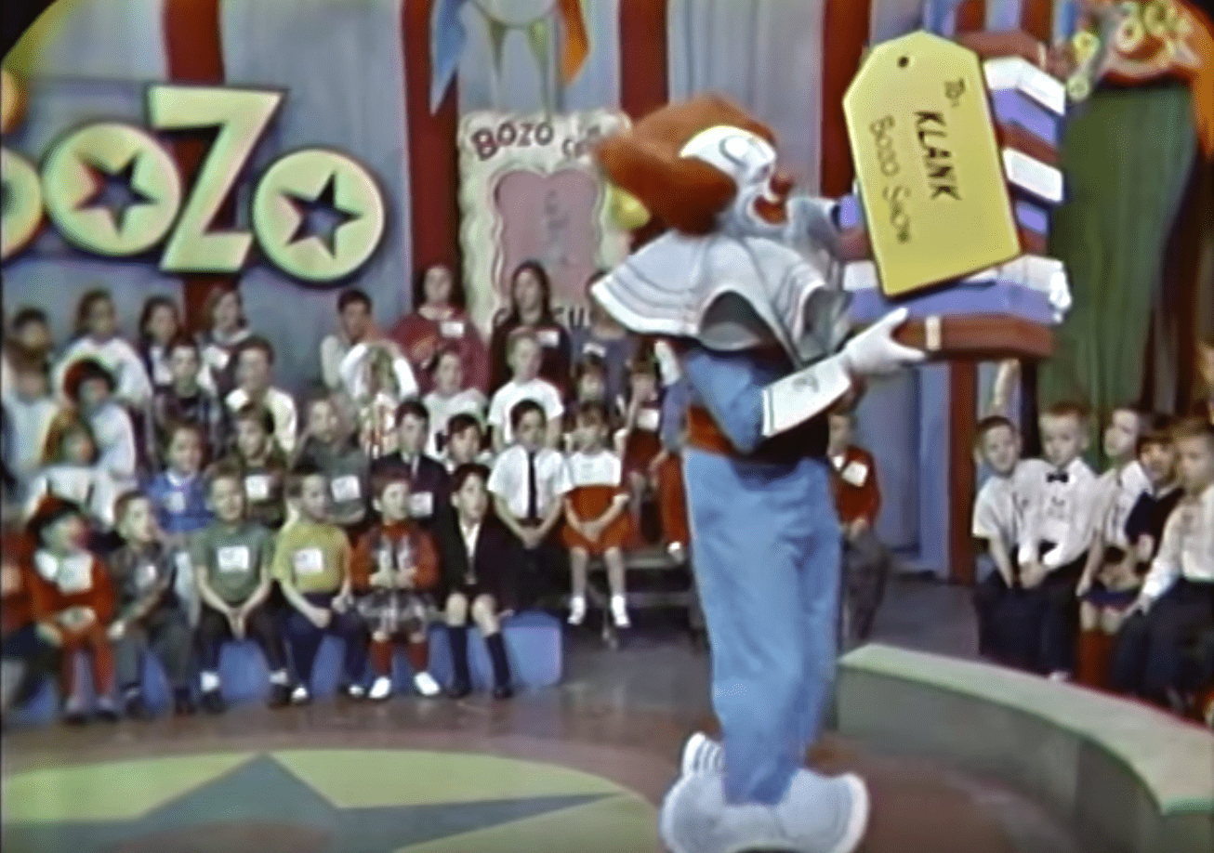
Facts about me:
I am married with two daughters.
I was on a tv show when I was little.
My favorite colors are green and yellow.
My favorite place is the beach or lake.
I have skydived!
I am a twin.

Slide 3
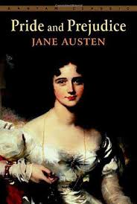
Favorite quote: “The more that you read, the more things you will know.. The more that you learn, the more places you’ll go”. -Dr. Seuss
In my spare time, I love to read.
Favorite books:

Slide 4
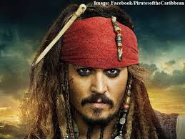
Favorite movies: Rocky movies and The Pirates of the Caribbean series
Favorite TV Show:The Walking Dead
(I have never missed an episode)
My favorite band is 38 Special and Big Daaddy Weave.
Fun fact: I have done all of the Walking Dead tours and have actually been in the spots where many of the episodes were filmed.

Slide 5
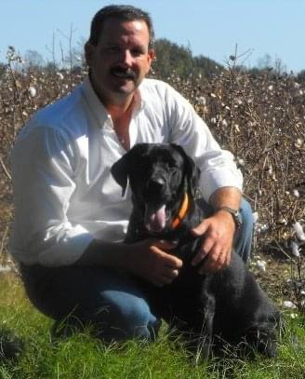
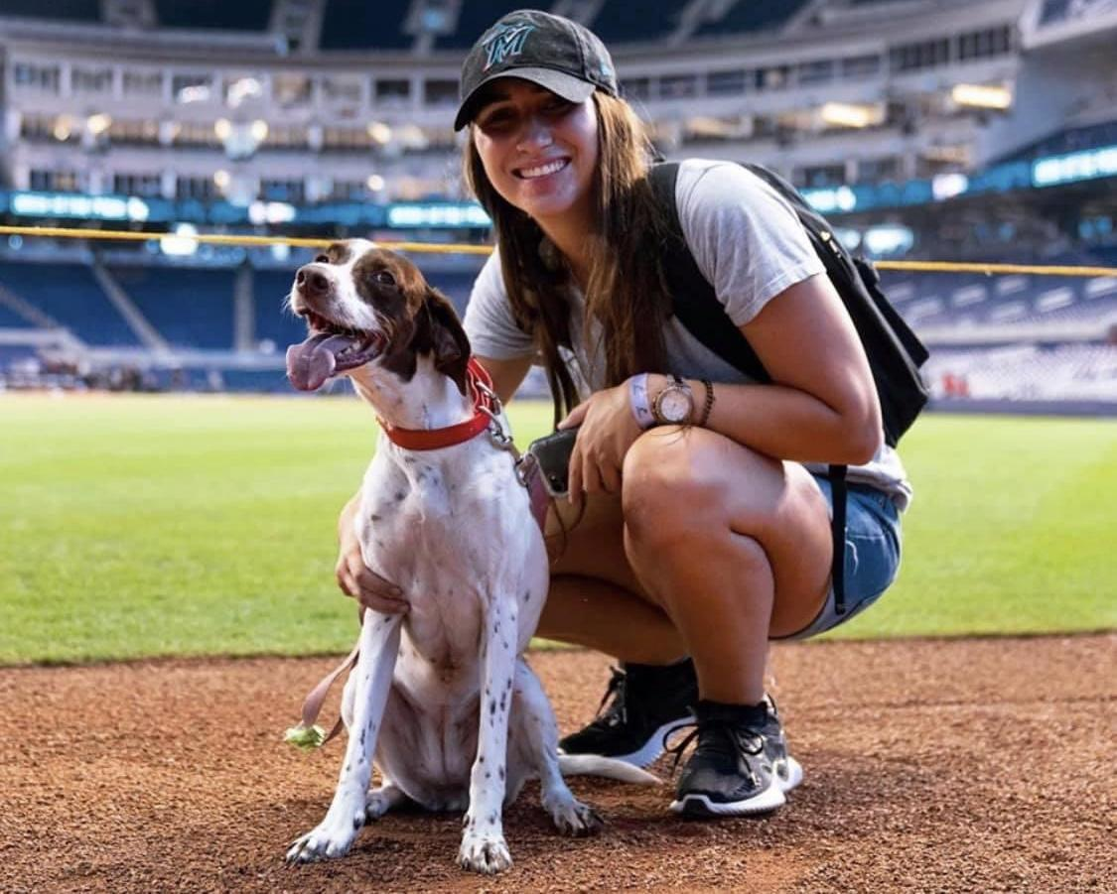
Meet Mike, my husband, who loves fishing, hunting, and his family! He graduated from Valdosta state and earned his bachelor’s degree and his master’s degree. Mike coached college baseball for over 20+ years. Fun Fact: Mike met and took a picture with Don Mattingly (New York Yankee player turned Miami Marlins manager) that our daughter arranged.
Meet my oldest daughter,
Jessica and her dog Rainey. Jessica is 28, graduated from Georgia Southern and works for the Miami Marlins (baseball runs in the family). Cool fact: Her boss is Derek Jeter (ask your parents who he is if you don’t know)...

Slide 6
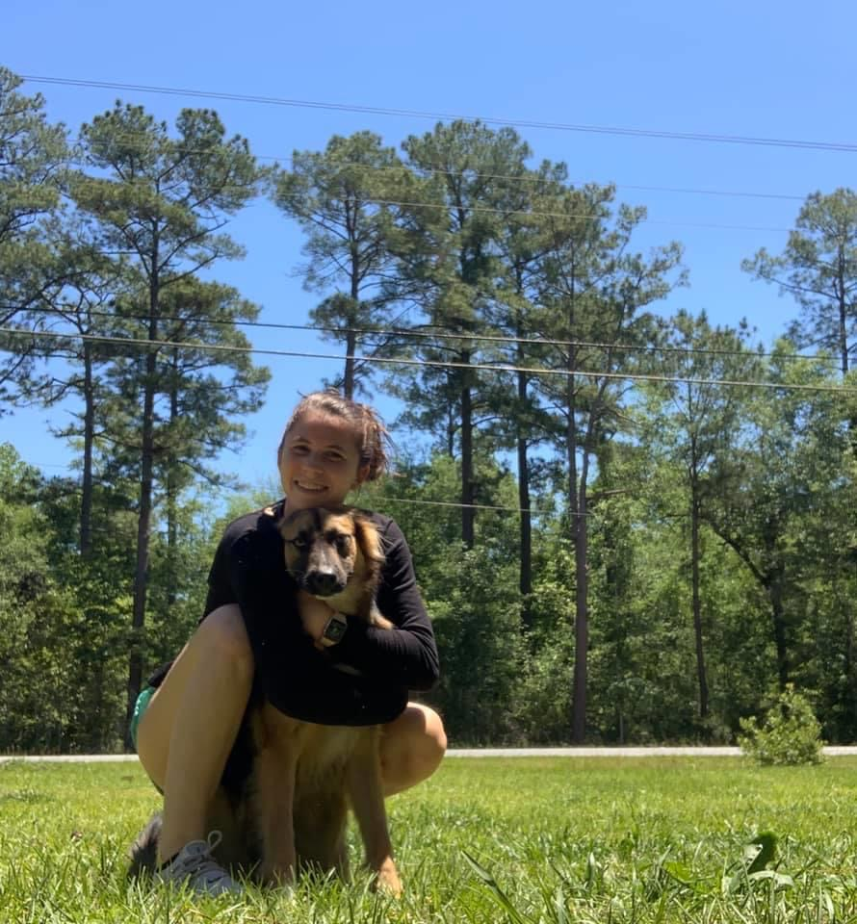
Meet my youngest daughter, Erica, and her dog Marley. Erica is 24 and graduated from Thomas University and Gannon University. She is is PA. Fun fact: Erica met (Scott Wilson -Hershel- from The Walking Dead and had no idea who he was). Yes, I was jealous!!!

Slide 7
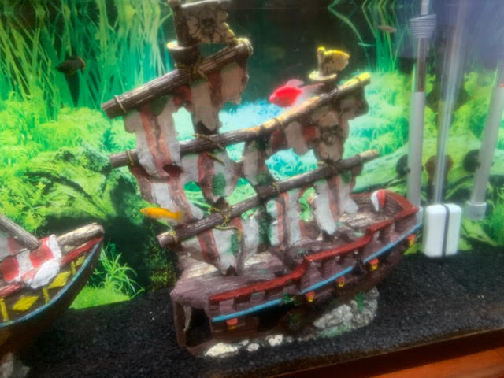
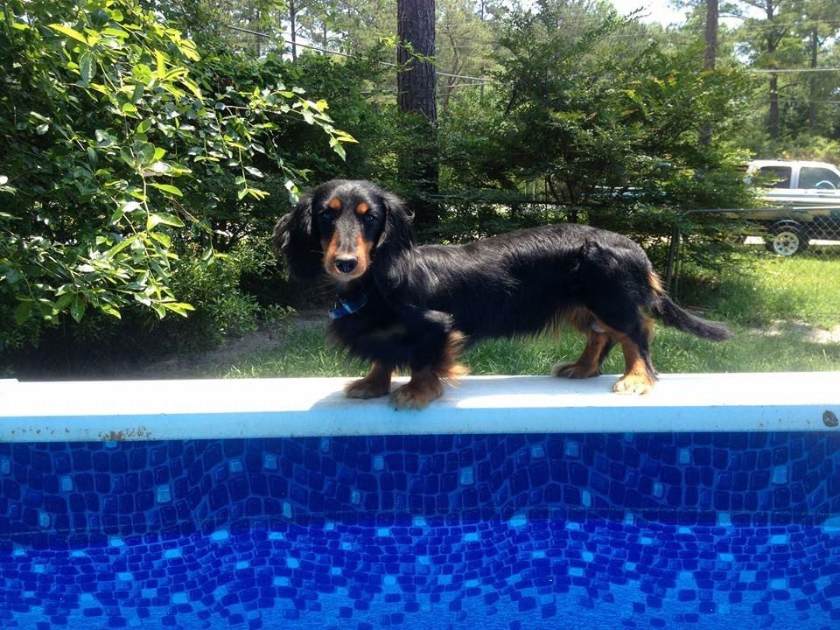
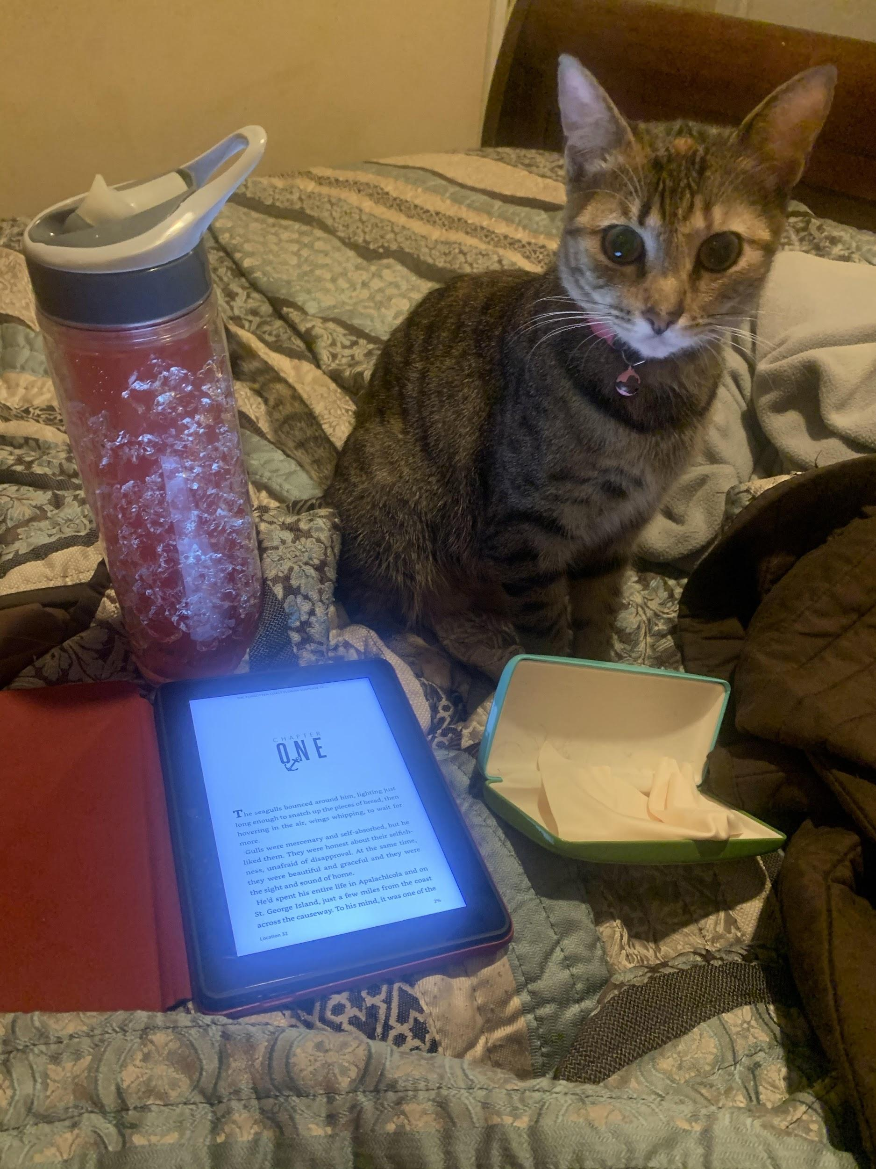
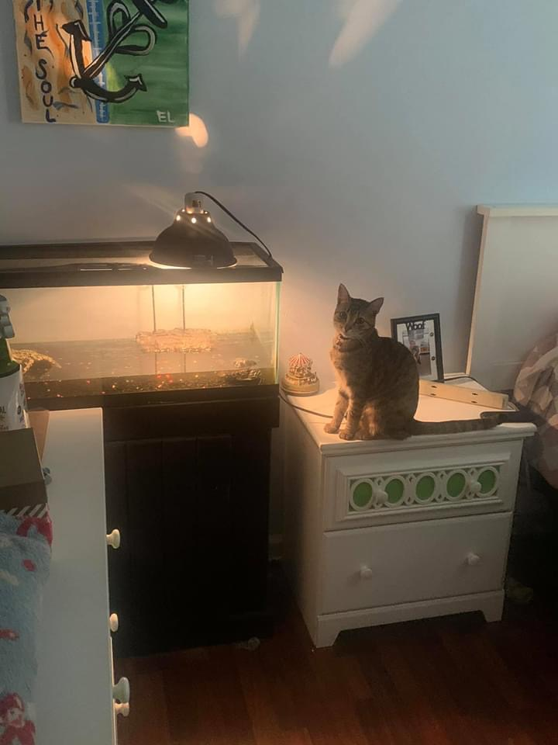
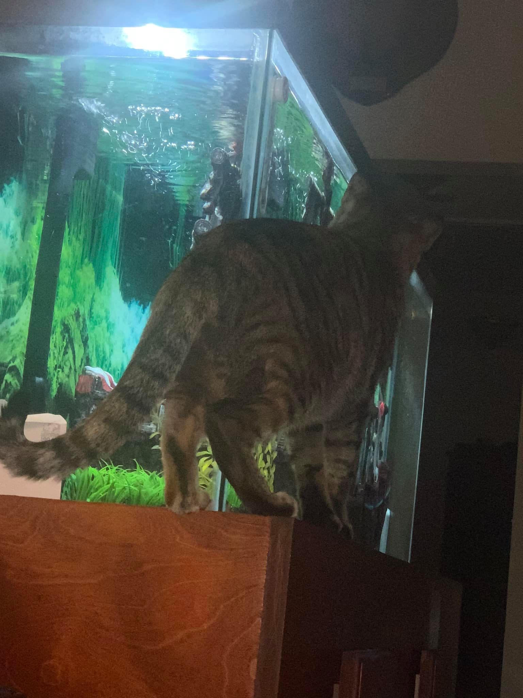
Meet the big dog of the house, my dog Sammy.
Meet the queen of the house,Koda, my cat.
My fish and they all have a name.
Koda found Timmy, the turtle.
Koda found the fish.

